Slide 1
How Does Innovation Break Through in the Canadian Mineral Analysis Market?
Some Recent Case Studies with Key Learnings
Ernesco Technical + Advisory Services Inc.
Presented by: E. A. Kuhnert – President
April 25, 2023
2023 Canadian Mineral Analyst Conference - Pointe Claire , PQ

Slide 2
Overview
Purpose:
Using a Technical Marketing lense, present 3 innovation case studies to interested Mineral
Analysts.
Process:
Introduction
Business Landscape – Barriers to Entry
Case Study 1: Regional Assayer/ New Service Segment with new Technology differentiation
Case Study 2: Int’l Eng Co/ New Market Entry with new Technology differentiation
Case Study 3: Local Assayer/ Under Served Segment with Customization
Key Learnings + Take Away Message
Discussion
Pay Off:
Understand how innovation is penetrating the Canadian Mineral Analysis market and how it can
benefit you.
Know YOUR Value.

Slide 3
Introduction
What does ETAS do?
We are a boutique engineering consultancy advising on chemistry, chemical engineering and industrial marketing
to businesses engaged in new chemical transformation technology development.
We fill in the gaps in your commercialization team by undertaking multiple mandates.
Plug the Gaps on the Client’s Team
Test the Market – Can we Win? Is it Profitable?
Penetrate the Market – Bring the First Clients
Advance the Team – Can We WIN in the long term?
We specialize in providing innovation and commercialization management services to chemical technology
entrepreneurs moving them rapidly and with lower risk through cultural interplay – from ideation to early stage
financing and beyond.
What is Technical Marketing?
It is the creation and development of sustainable technical leadership resulting in relevant commercial significance
and profit.
With unique technical capability or intellectual property monopoly (patents), technical marketers create and nurture
competitive advantage causing long term sustainable profit and sales growth resulting in stable and prosperous
companies.

Slide 4
Business Landscape – Barriers to Entry
There are many Barriers to Entry. We focus on these 2 in the presented cases:
1/ Mining Industry Cyclicality
- Cause = Cashflow Droughts
- Effect = Extinction Event
2/ Consolidation (Global Competition)
- Cause = Predator vs Prey
- (In Dr. Seuss lingo - Biggering and Biggering)
- Effect = A Status Quo Event [Remove the Innovator and Take Away the Choice]
Overcoming the Barriers to Entry:
All the Case Studies presented demonstrate:
Entry into New Business through Internal Development applying Differentiation… usually with new technology [the Innovation].
Innovation always targets/ addresses: CHEAPER, BETTER, QUICKER. Home Runs = Deliver on all 3 promises.
Reference:
Competitive Strategy: Techniques for Analyzing Industries and Competitors
By Micheal E. Porter, 1980

Slide 5
Case Study 1: Regional Assayer/ New Service Segment with new Technology differentiation
Innovation?
New German automated pulverization technology
Service Design: Balanced service quality with predictable, timely results delivery.
Approach?
Grew from a local assayer into a regionally meaningful service over 10 yrs.
Provided exploration firms a means to discipline/ control poor service performance by large LabCos.
Early service adopter of new German automation approach.
Outcomes?
Caused large LabCos to dramatically improve service timeliness and performance.
Boosted market choice and competitiveness.
Introduced, proved and established new EU assayer technology in NA.
Where Now?
During mining down cycle, became insolvent [one trick pony].
2 sites acquired by separate multi national LabCos.

Slide 6
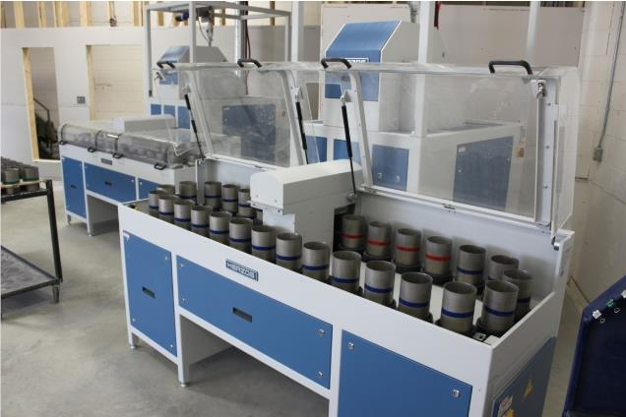
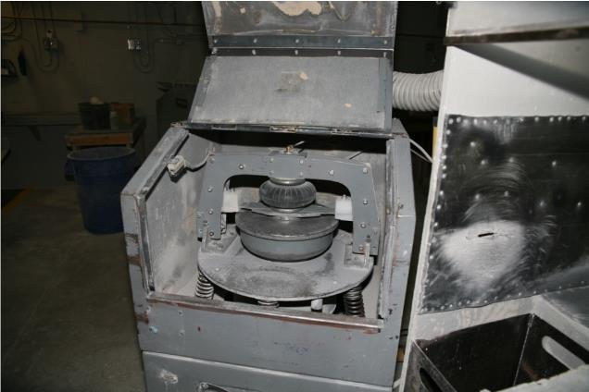
Change the Game: Advanced Technology FOCUS
Pulverizer Automation/ German Engineering
NOW
HISTORICAL
Manual pulverizer
Automated HP-M1500

Slide 7

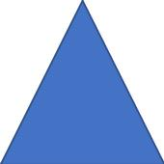
Change the Game:
Balancing Predictable Service Delivery Speed with Consistent Quality

Slide 8
Case Study 2: Int’l Eng Co/ New Market Entry with new Technology + Engineering differentiation
Innovation?
World leading engineering designer for high volume geochem labs moving lots of rock.
Employed leading edge robotics/ analyzers with meta data software/ LIMS.
Strong/ competent PM Service program.
Approach?
Dominant iron ore market position globally. Deployed critical reference list of global opinion leaders.
Differentiated position with key German OEM technology maker.
Demonstrated engineering competence in robotics and mechatronics (new engineering disciplines)
Outcomes?
Penetrated NA market. Grew more quickly in USA than Canada [surprise outcome]
Learned Canada is quite slow/ reluctant to deploy major CAPEX for game changer solutions.
S. African and Australian markets early adopters
Where Now?
Founders/ owners retired. Sold firm to fund retirement.
Acquired by Scandinavian Mining OEM Integrator.

Slide 9
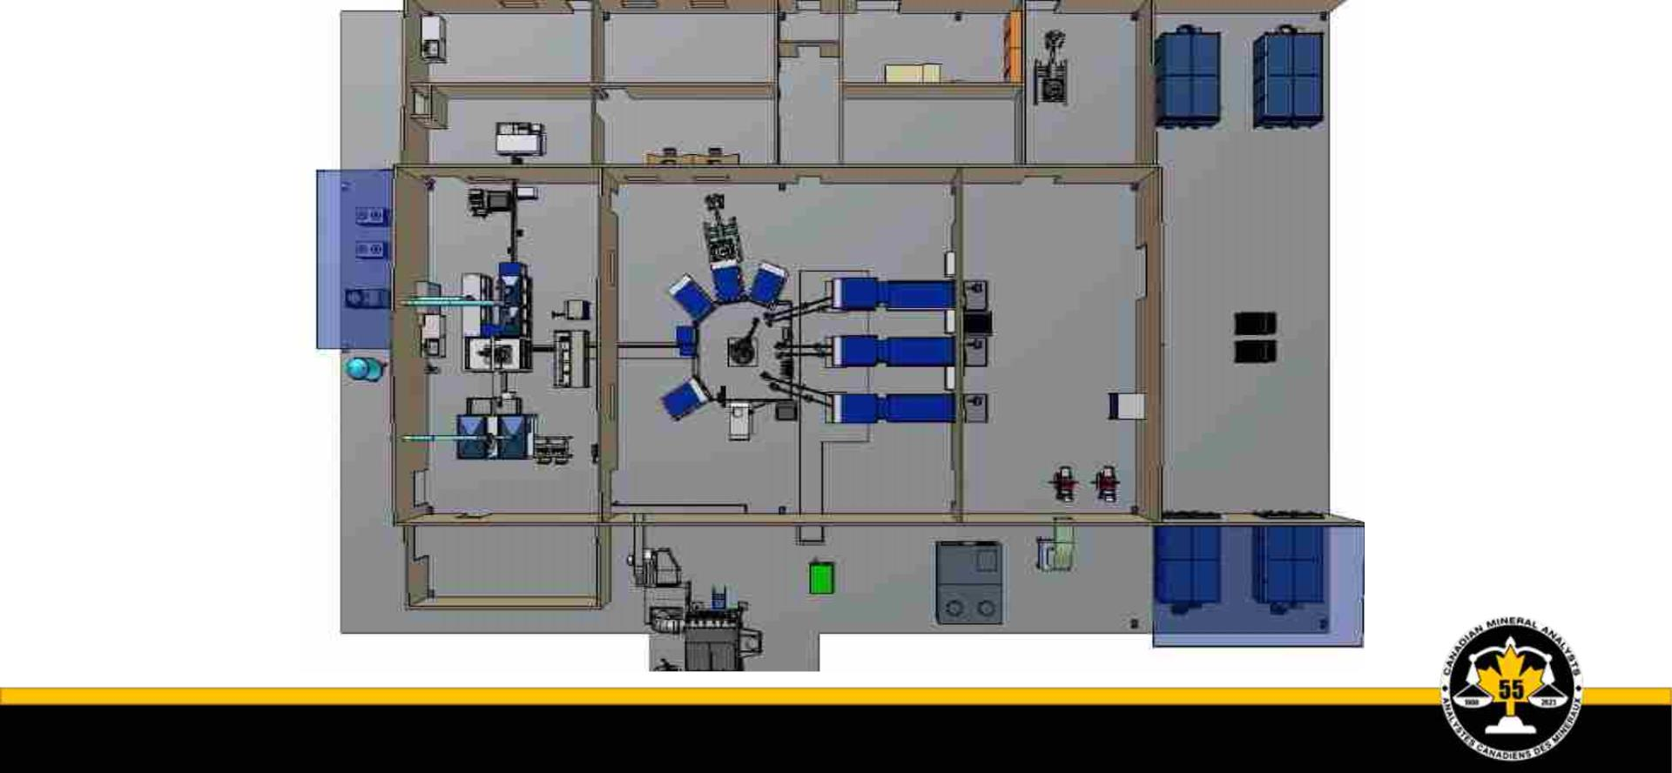
Customized Mine Lab Design with High Degree of Automation

Slide 10
Case Study 3: Local Assayer/ Under Served Segment with Customization
Innovation?
Special testing focus on unique geochem deposit dynamics ( Analytical Chemistry Recipes)
High customization and localization of service. Timely + predictable delivery of results
Approach?
Local – On a When + As Needed Basis
Outcomes?
Highly responsive, tailored. Large gains in ‘speed of analysis’ and deposit valuation over a 1 year trial.
Recruitment + retention of Chief Chemist a major challenge. Capex and Permitting also difficult.
Where Now?
Site program closed. Jr. Explo firm too uncertain on drill program funding and timing.
Assayer continues to serve the Iron Ore segment

Slide 11
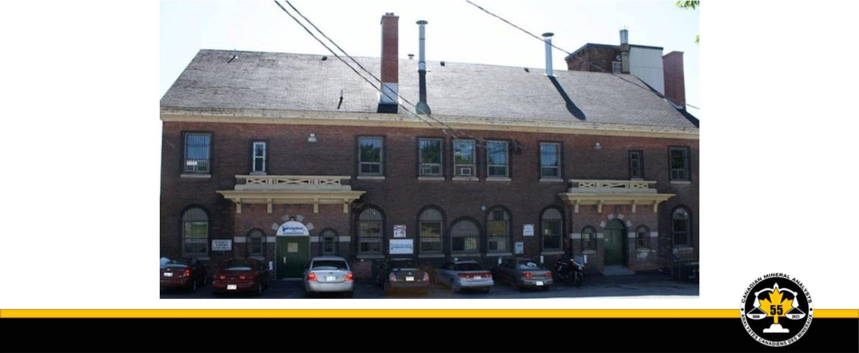
Service Lab – Resurrection: Repositioning, Repurpose, Refinance, Restaff

Slide 12
So What? …..Key Learnings for the engaged Mineral Analyst
The GOOD
Innovation is achieving break through + reaching the mineral analyst regularly.
Innovation is always 2 out of 3: cheaper, better, quicker…but seldom all 3.
The BAD
Canadian miners are slow adopters. Risk capital is scarce and sticky to deploy due to necessary adult supervision.
Innovation’s impact is curtailed by mining cycle contractions and financing droughts. Proven Capex vaporization history.
The Miner prefers to buy bigger shovels, bigger dump trucks – instead of mining more intelligently. Poor selection. Why?
The UGLY
Innovation’s impact is diminished by consolidation, integration leading to a less effective mining industry viability. Why??
Your KEY Take Aways?
• Do you capture and exploit the innovations that reach you?
• Do you measure and hold the gains?
• How to do it? Consult: Competing on Value by Mack Hanan (1991). KNOW YOUR VALUE (Chpts 2 +5)

Slide 13
Contact Details: Questions? Discussion?
Ernesco Technical + Advisory Services Inc.
www.ernescotech.ca
Mobile: 613-204-7503
Linked In: See Alex’s Profile
Email: alex.kuhnert@ernescotech.ca
Need Help?
Please consider my firm and give us - the call.

