Slide 1


How Management Preferences Matter
An Industry Marketing Review on the Automation Decision
Sept 13th Automation Seminar
Presented by Alex Kuhnert, P.Eng.
www.ernescotech.ca

Slide 2
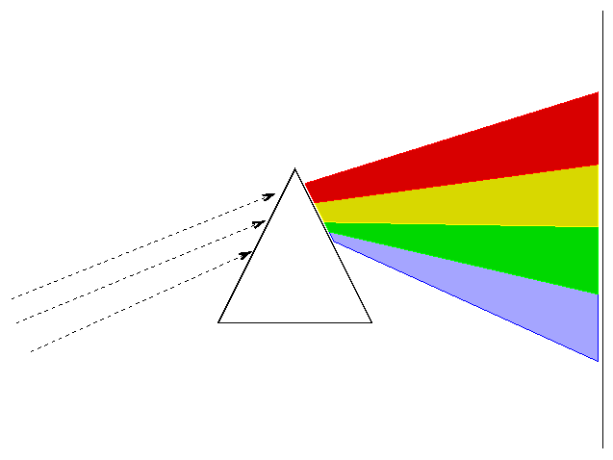
Do I Automate? And How Much?
A Range of Factors Will Determine Automation Scope
Complete automation
Hybrid: Automated Zones
Sample throughput
Client Projects lifespan
fxn
Hybrid: Linear Stages
Hiring practices (CSR)
Scope of Testing
Hybrid: Modular Units
No automation
We want to assess the Critical Success Factors (CSFs)

Slide 3
Critical Success Factors (CSFs) in Similar Business Scenarios
Reference: Dinesh Kumar, K., Roth, H., & Karunamoorthy. “Critical Success Factors for the Implementation of Integrated Automation Solutions with PC Based Controls”. Proceedings of the 10th Mediterranean Conference on Control and Automation. – MED2002. Lisbon, Portugal, July 9-12, 2002.
Note that Management is listed specifically in two of these scenarios.
Introducing automation to a lab can be like New Product Development

Slide 4




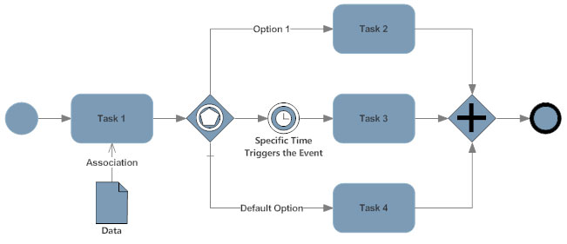



Three Key Factors in a Lab’s Automation Decision
1) Resources
  Money, time, people
2) Organizational Capability
  Skills, procedures, etc
3) Management Preferences
  Stated or unknown

Slide 5
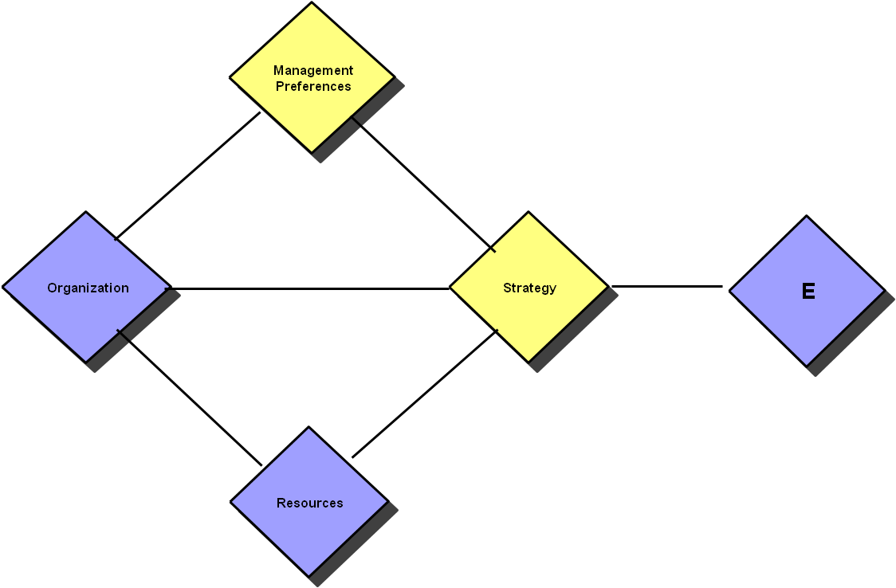
Management Preferences Is Actually the Main Determining Factor, but Often Considered Last
Fry-Skilling
Strategy Model:
Corporate culture, experience,
leader/follower status, etc.
3
2
(Environment)
1
Procedures,
Skills, Coordination
What Drives Consideration of Automation:
New projects or aging systems
Chronic quality problems
Expanded sampling volume
New testing parameters
Staff shortage or FIFO costs
Money, people, time

Slide 6
How Management Preferences Impact the Decision to Automate
Does automation align with our brand?
Does automation align with our focus for the fiscal year?
Does automation align with our CSR position?
Does automation align with our operational norms and/or culture?
Does automation align with my personal experiences and opinion?
Level of Risk

Slide 7
Brand: Innovation
“If ore is being hauled by a herd of elephants, and we automate the control of those elephants, then we’re still using elephants. That’s not what I want from automation.”
- Executive at international gold miner
Context: this miner’s brand was “Technology Leader”
Interested only in automation that included a new or different process, regimen or technology. Simply replacing people was not good enough.

Slide 8
Focus for Fiscal Year: Production
“If it doesn’t pull more ounces out of the ground, I’m not interested”
- Executive at international gold miner
Context: gold at an all-time high
Unspoken preference: it should directly pull ounces out of the ground

Slide 9
CSR: Safety
“We’re not a mining company with a safety problem. We’re a safety company with a mining problem”.
- Executive at international iron mine
Context: iron prices were high; Australian work culture focused on safety across the board; high FIFO costs

Slide 10
CSR: Jobs for the Community
“I don’t want automation. I want you to manualize my entire mine”.
- Executive at third-world mining project
Context: mine being constructed; corporate tax savings based on overall number of FTEs; a one-mine company.

Slide 11
Operational Culture: We “Get” Automation
“Automation is our tool to do what we do better. We know it, we use it. Simple as that.”
- Executive at Canadian miner
Context: history of automation applications across several disciplines: IT networks, software, exploration, transport, mill operation….
A history is key not only in automation decision but in keeping a high level of success in implementing and using automation

Slide 12
Operational Culture: Low Capex
Company 1: Bought and installed used SAG mills, saving multiple millions on initial capital outlay. Corporate success story that trickled down to all management including the lab. Several discussions, proposals. Outcome: deferred indefinitely.
Company 2: Lab Manager “wanted” automation, but the internal process for validating the spend on such a project was apparently too rigorous, and budgets were kept in line with historical spends to manage against commodity pricing uncertainty. Outcome: bought a used dryer on Craigslist (yes this is true).
Context: both are base metal miners, in a market with a history of unstable and widely-ranging commodity prices
Alarm bells regarding used automation; alarm bells on inefficient sales process

Slide 13
Level of Risk: Possibly the #1 Consideration
“I love everything about automation, except when it breaks down”.
- VP Sequencing, New York Genome Center (2016)
Reference: https://www.labmanager.com/ask-the-expert/2016/12/drs-swerdlow-and-simpson-on-trends-in-lab-automation#.XXeH6HdFxuk
“We are first adopters…but we are not navigators”
- Lab Exec during a recent CMA event
Supplier and Buyer Need to De-Risk the Process and the Project

Slide 14
Strategies for De-Risking Lab Automation
Use what has worked before
  In very similar applications (same market, same matrix, same scope)
  In similar process models from other lab markets (clinical, pharma)
Redundancy in equipment and/or backup in process
  Standby units (requires additional capex, footprint, operational readiness)
  Manual processes (requires skills, procedural complexity, parts/maintenance management)
Produce cost/benefit and ROI models that cover all variances
  Adjust payback scenarios on the basis of variance of inputs (quantity, mass, matrix chemistry, etc) and variance in equipment uptime (85%, 90%, 95%, etc)
Develop the accountable service model: who, when, how, and costs

Slide 15
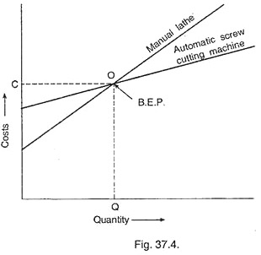
Financial Models on Sample Input Scenarios
Sample Throughput | Implications
Highly variable (unpredictable) about B.E.P. | Strategy to develop better input controls
Ranges predictably above and below B.E.P. | Strategy to increase minimum daily loading. Strategy to tighten range.
Always exceeds B.E.P., but variances produce Payback Period that only sometimes meets requirement. | Strategy to increase lowest daily loading sources. Modification of automation scope.
Manual Lab
Automated Lab
Breakeven Point Dependent on Sample Throughput

Slide 16
What Is the Takeaway Message?
Understand the Management Preferences that impact the decision-making in your (or your customer’s) company
Do this homework upfront to reduce time and cash investments in the sales and project design/specifications stage
  GO or NO-GO Decision
Prepare as much justification as possible, and be conservative
De-risk the project scope and design
Every Case Is Different; Plan Well

